Slide 1
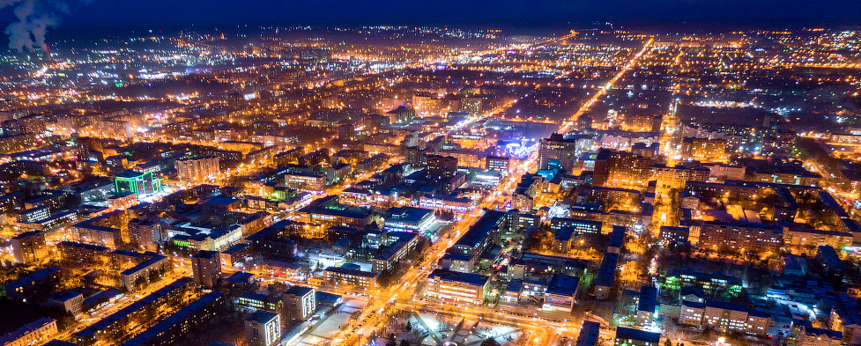
Investment Portfolio of
the city of Blagoveshchensk
2024

Slide 2
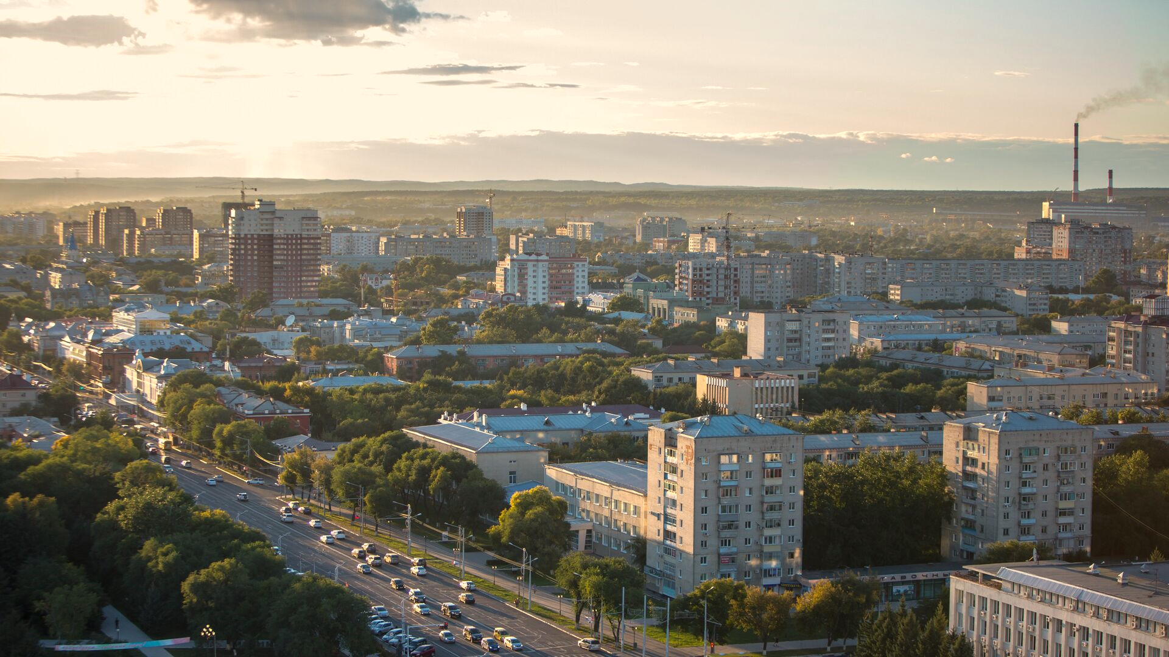
The publication contains the information for 2023

Slide 3
3
Contents
Address by the mayor of the city of Blagoveshchensk………………………………………………………………… | 4
General information……..……………………………………………………………………………………………………………. | 7
Logistics and communications………………………………………………..……………………………… ………………… | 9
Population and labour force…………………………………………………………………… …………………………..…… | 12
Tourism………………………………………………………………………………………………………………………………..……. | 14
Social infrastructure…………….……………………………………………………………………………………………..…….. | 17
Economic potential…….……..…………………………………………………………………………………………………..….. | 19
Investment climate………….…………………………………………………………………………………………………….…… | 23
State and municipal support of investment activity……………………………………………….………..………… | 24
Investment projects………….……………………………………………………………………………………………..………… | 25
Legal regulation of investment and business activities…………………………………………..………………….. | 46
The support of investment and business activities…………………………………………………………….….…… | 49
Reference information for investors and entrepreneurs…………………………………………………….………. | 54

Slide 4
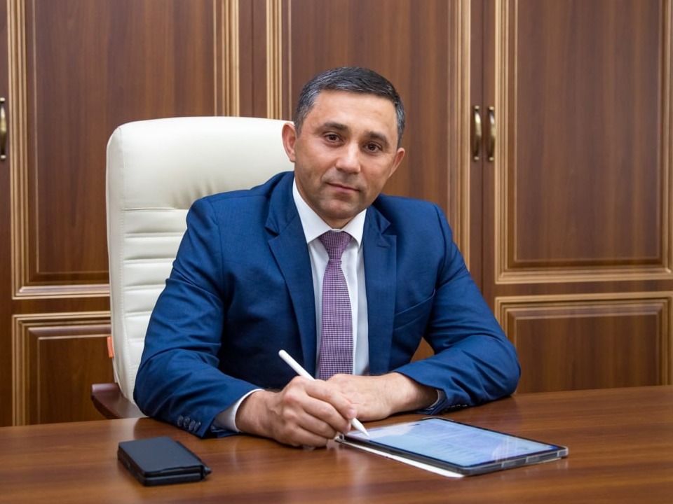
4
The mayor’s address

Slide 5
5
Dear investors and entrepreneurs!
Our city was founded in 1856 as the Ust-Zeya military post on the Amur river, on the border with China. Today Blagoveshchensk is an administrative, political, business, industrial, scientific, educational and cultural center of the Amur Region. The city administration does its best to increase the attractiveness of the business climate of the capital of the Amur Region.
The unique geographical location on the border with China, the presence of a customs crossing and a developed transport infrastructure - an international airport, railway, road, river transport - contribute to strengthening the economic and social cooperation between Russia and China. The cross-border bridge and cableway across the Amur River open up new opportunities for the development of tourism, trade and industrial production.
Large investment projects are being implemented on the territory of Blagoveshchensk, the city is open to new business partners. Our investment policy is aimed at supporting competitiveness, reducing administrative barriers, supporting promising projects and establishing effective cooperation with investors in all industries.
We are ready for dialogue with the investment community.
We invite you to evaluate the investment potential of our city and the prospects for joint work.
The mayor of the city of Blagoveshchensk
Oleg Imameev

Slide 6
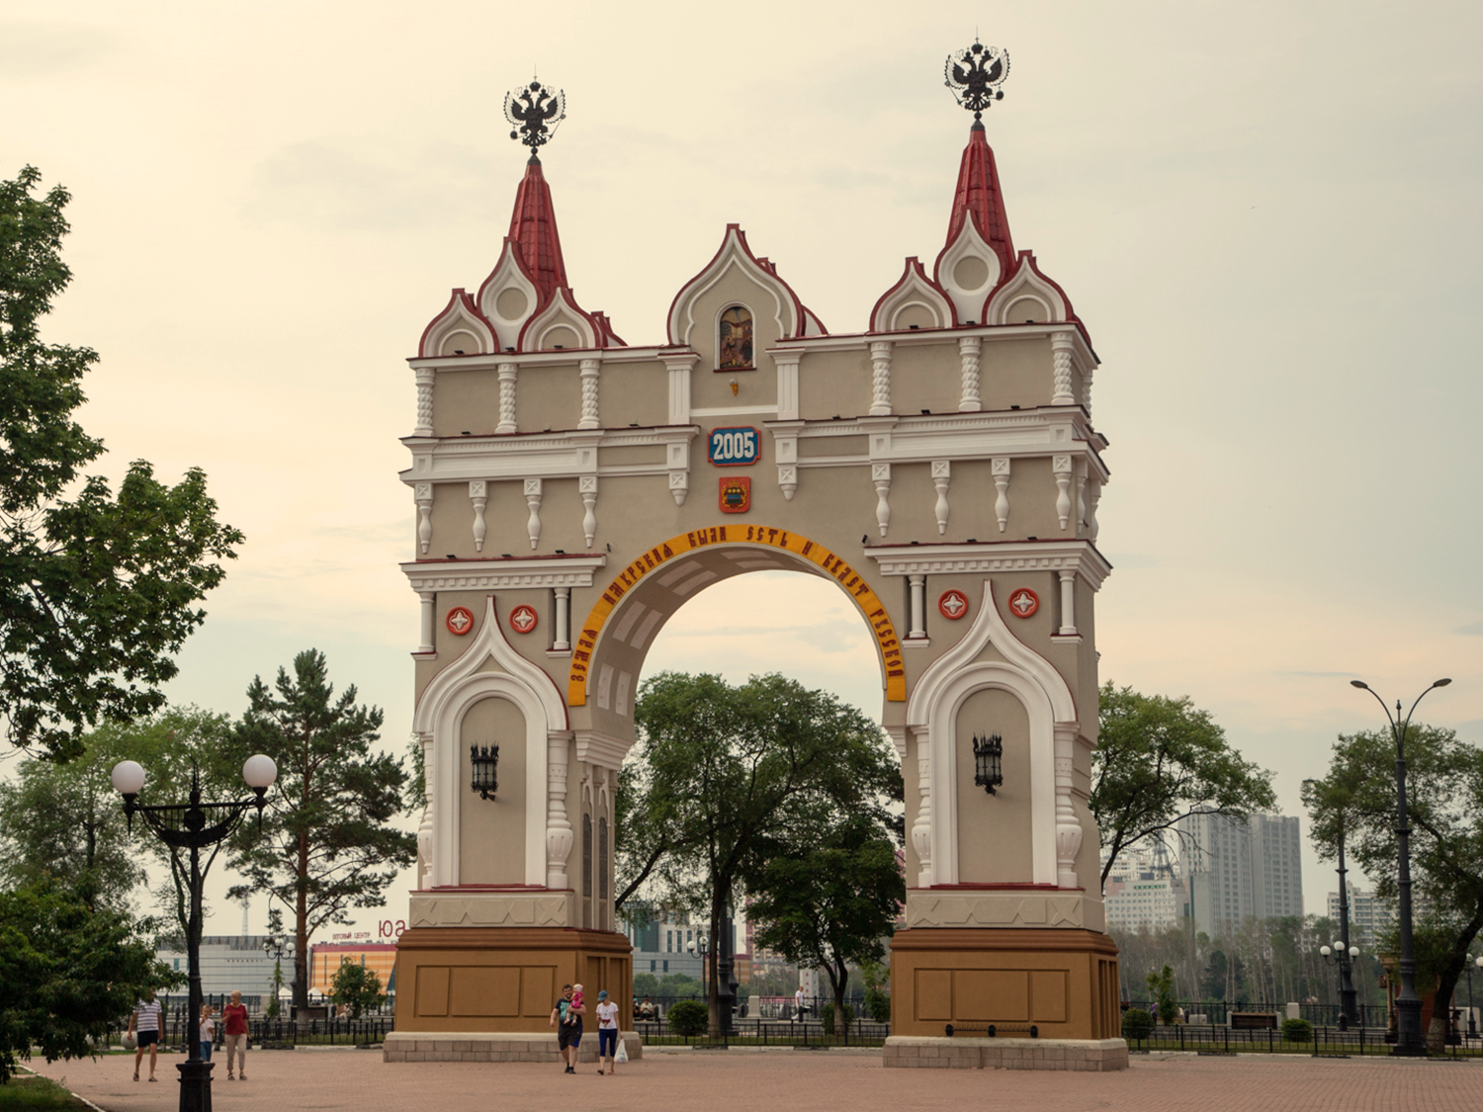
6

Slide 7
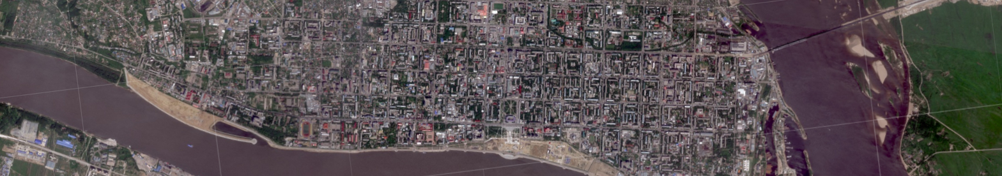


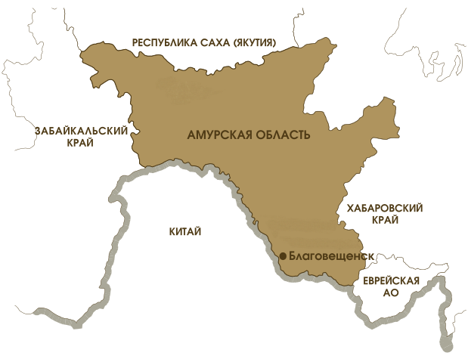
7
General information
Foundation date: 1856 year
Total area: 321 square kilometers
Population: 245,6 thousand people
Population density: 766 people per square km
The territory of Blagoveshchensk includes villages: Belogorie village, Mukhinka settlement, Belogorie and Prizejskaya railway stations, Plodopitomnik village, Sadovoye village.
Climate: Blagoveshchensk is located in the south of Amur region in temperate geographical zone, monsoon climate prevails. The average temperature of January : – 21°С, The average temperature of July: +22,2°С.
Time zone: UTC+9/MSK+6. Calling code: +7 4162.
Natural resources: The city of Blagoveshchensk is located on the left bank of the Amur river, where the Zeya river goes into it. The Burhanovka and the Chigiri rivers flow in the Amur-Zeya river valley on the territory of the city. Plantation of trees in the modern area of the city is 11 783,0 hectares, which corresponds with 36,7% total area of the city. The largest area is occupied by city forests - 11 185 hectares, which are located as large tracts and consist of Mongolian oaks, birches and pine trees, which are also valuable for recreation.
Minerals: There are rather rich reserves for mineral deposits within the territory of city district: natural sand, quartz sand, construction sand, pebble, gravel, ballast, peat, loam for M 125 bricks, clay for ceramic bricks, loam for M 500 expanded clay, clay for expanded clay, granodiorite for processing ballast into concrete, silicate sapropel.
Blagoveshchensk is the administrative center of Amur region and is located in the Far Eastern federal district of the Russian Federation.
The city of Blagoveshchensk is the only one among other regional capitals of the Russian Federation which is located on the state border. Blagoveshchensk and the Chinese city of Heihe are divided by 800 meters of the Amur river.

Slide 8
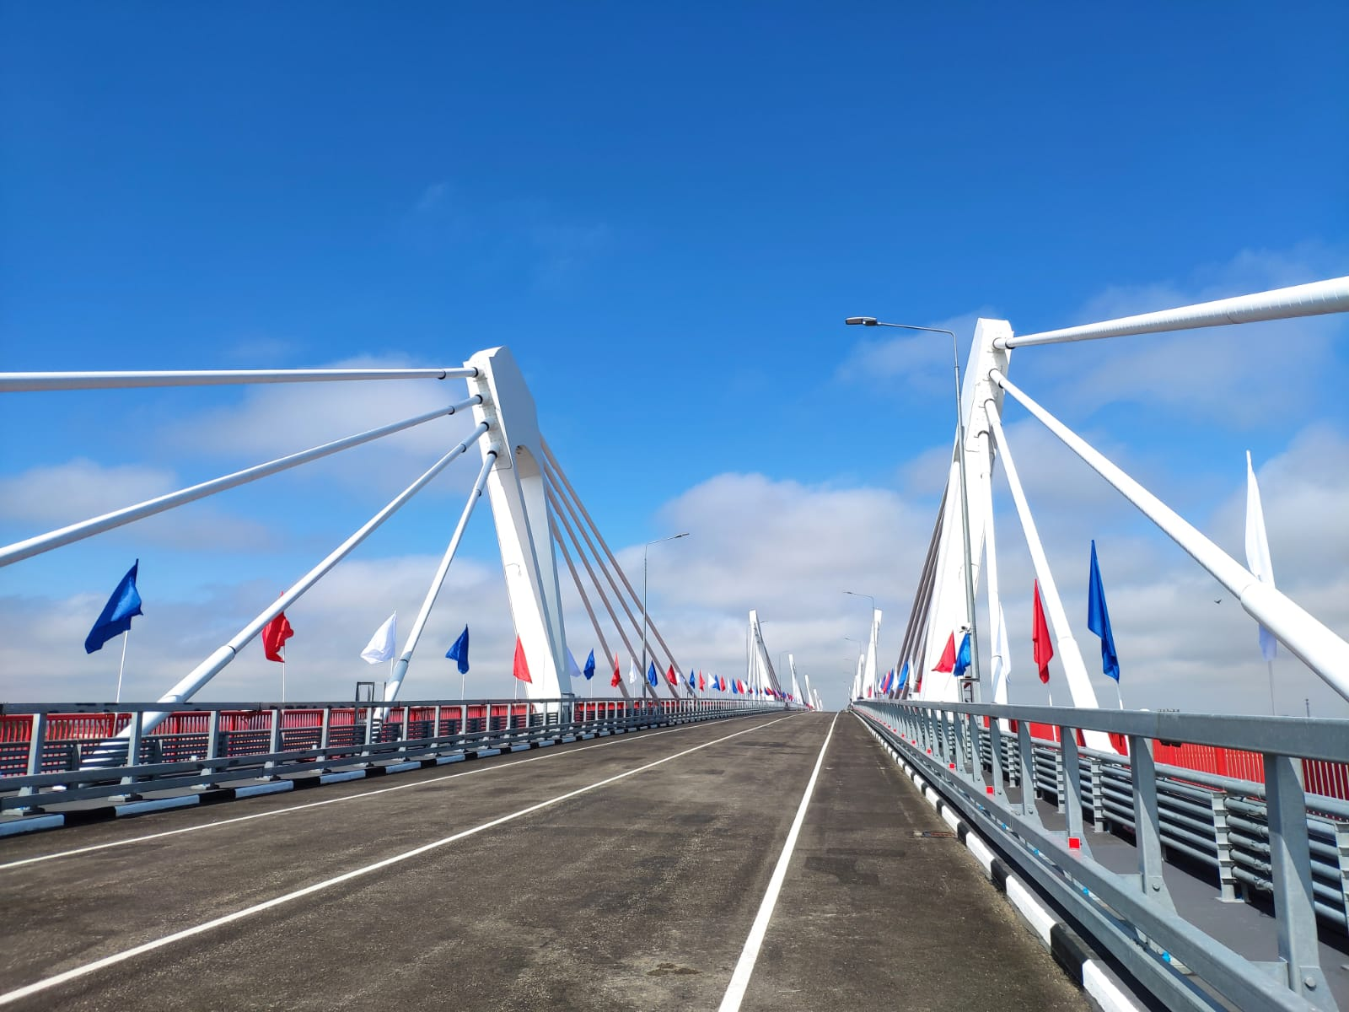
8

Slide 9
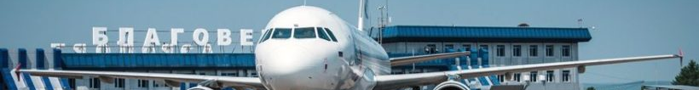




9
Logistics and communications
Blagoveshchensk is one of the most developed border cities of the Far East. It has the formed logistics: railway, air, river and road transports. The customs is the transit center for tourists and for product’s import and export as well.
Road transports
Railway transports
The total length of the municipal route network (in one direction) is 505 km.
Trucks' freight turnover of large and medium-sized enterprises of all types of economic activity in 2023 was 105 646,6 thousand tons-km.
Passenger turnover of road public transport was 34 003,3 thousand passenger-km.
The railway station "Blagoveshchensk" is a freight station of the 1st class with a parallel arrangement of parks. The volume of loading and unloading operations performed is more than 3.8 million tons per year. Long-distance trains run through the station in the following directions: Moscow; Chita; Tynda; Khabarovsk; Nizhny Bestyakh (Yakutia); Vladivostok; Belogorsk.
Inland water transport
Air transports
2 big enterprises of river transport:
CJSC «Blagoveshchensk Trade Port»
transportation and transhipment of soya, coal, container, timber, unitized cargo, bulk cargo
non-metallic building materials mining
In the summer, cargo ferry crossing is on work, but in the winter it is pontoon bridge, which connects Chinese and Russian ports.
CJSC «AmurASSO passenger port»
Transportation of passengers and cargoes, including outsized cargo
Loading and unloading operations
Warehousing
Customs clearance of goods
Blagoveshchensk Airport is part of the national core airport network and is included in the list of airfields of federal significance. The class B runway allows servicing all types of aircraft and helicopters of domestic foreign production. Passenger transportation is carried out in domestic and international directions. About 400.0 thousand passengers are transported annually.
Destinations of The Blagoveshchensk airport (Ignatyevo)
Moscow |  | Komsomolsk-on-Amur
Vladivostok |  | Sochi
Irkutsk |  | Svobodny
Chita |  | Oktyabrsky
Khabarovsk |  | Zeya
Yakutsk |  | Tynda
Novosibirsk |  | Phuket
Ulan-Ude |  | Utapao
Ekaterinburg
Yuzhno-Sakhalinsk | Domestic Russian flights
Krasnoyarsk | Intraregional flights
Magadan | International flights
Communications
General operator of fixed communications and internet service provider is “Rostelecom”.
Cellular operators: “MTS”, “Beeline”, «MegaFon», «Yota». In the city of Blagoveshchensk there are GSM- and CDMA- communications of Chinese operators China Mobile and China Unicom.

Slide 10


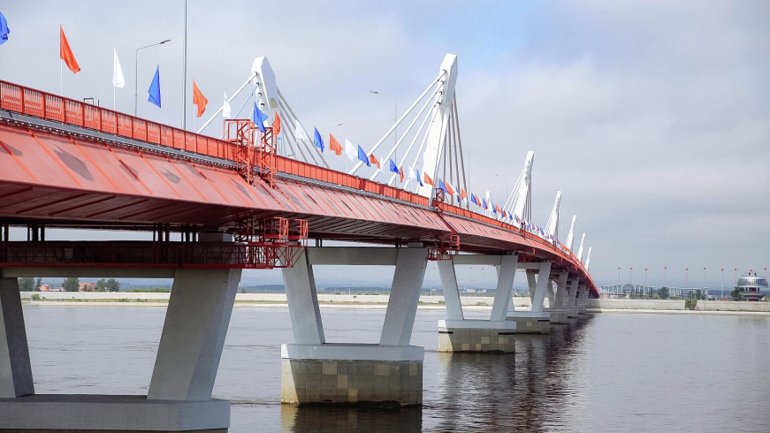
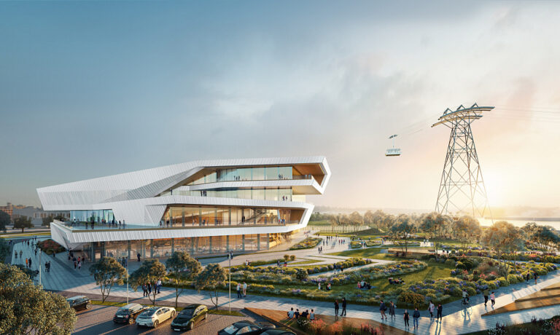
10
Logistics and communications
The Blagoveshchensk–Heihe Bridge
The Blagoveshchensk — Heihe Cable Car
The Blagoveshchensk - Heihe Bridge is the first and only bridge connecting the Russian Federation and the People's Republic of China. The total length of the bridge is 1,080.5 m. The state border runs in the middle of the central span of the bridge. Construction of the bridge began in December 2016 and was completed in May 2020, however, due to the coronavirus pandemic, the bridge was opened only on June 10, 2022. Currently, international traffic across the bridge is limited to cargo transportation. Passenger service is planned to be open in the future.
In addition to The Blagoveshchensk - Heihe Bridge, a cross-border cable car is currently under construction across the Amur River between Blagoveshchensk and Heihe. The start of construction was given on July 18, 2019. Initially, the commissioning was planned to be carried out in the first half of 2023, but due to difficulties with the supply of equipment necessary for the completion of the work, the launch was postponed to the summer of 2025.

Slide 11
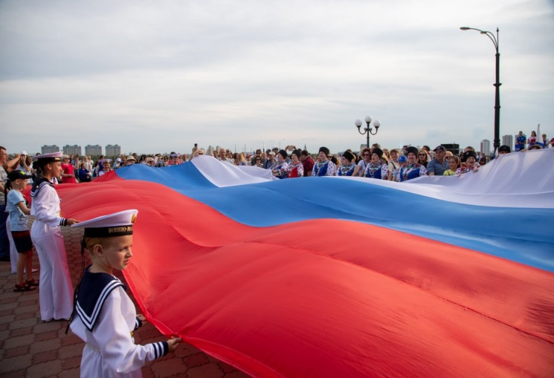
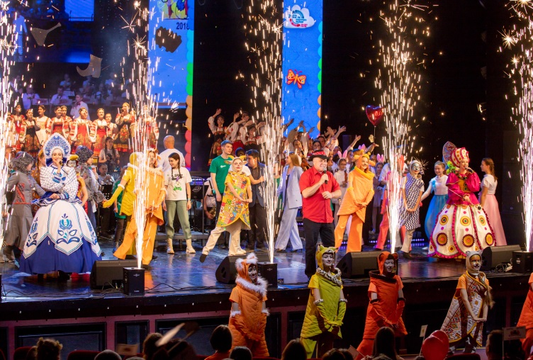
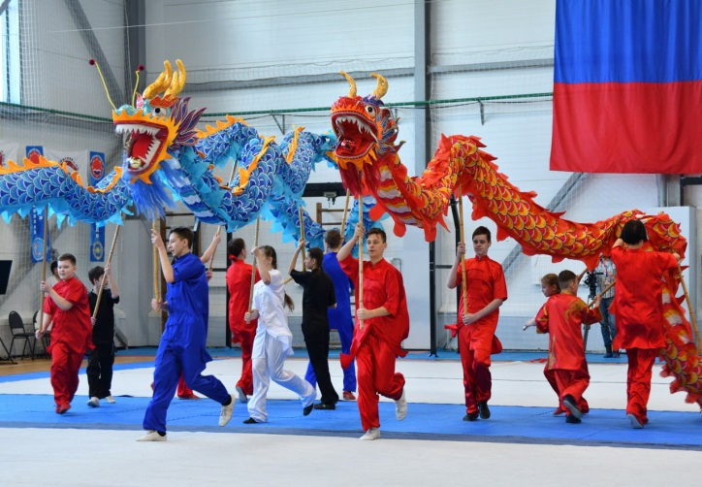
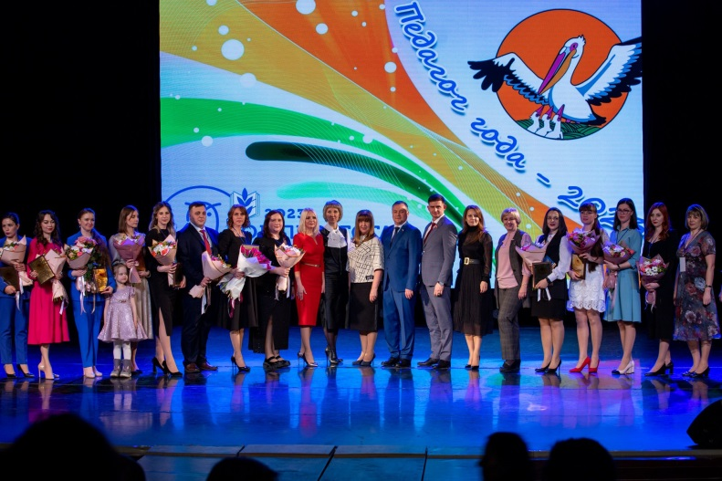
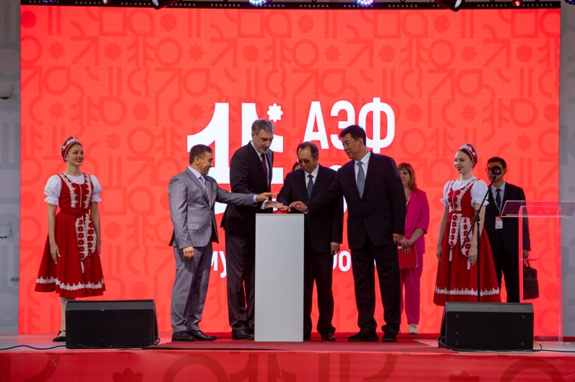
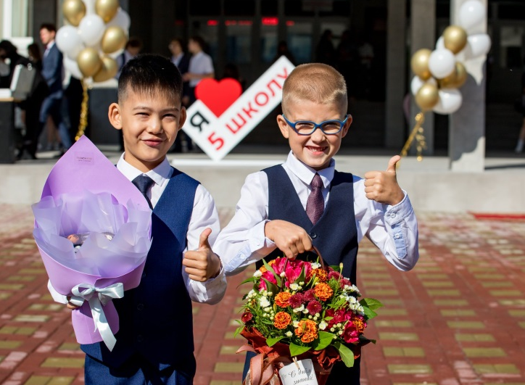
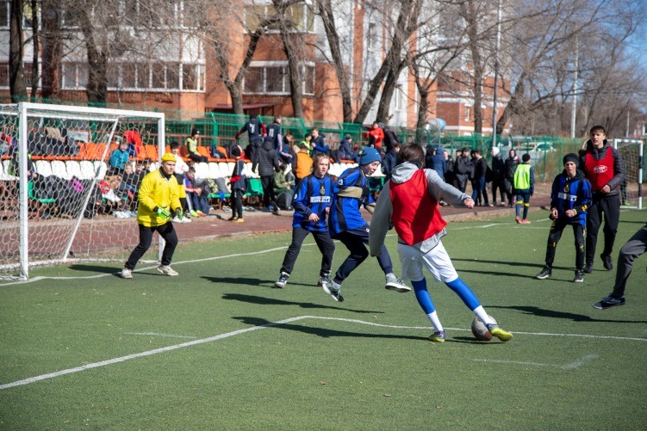
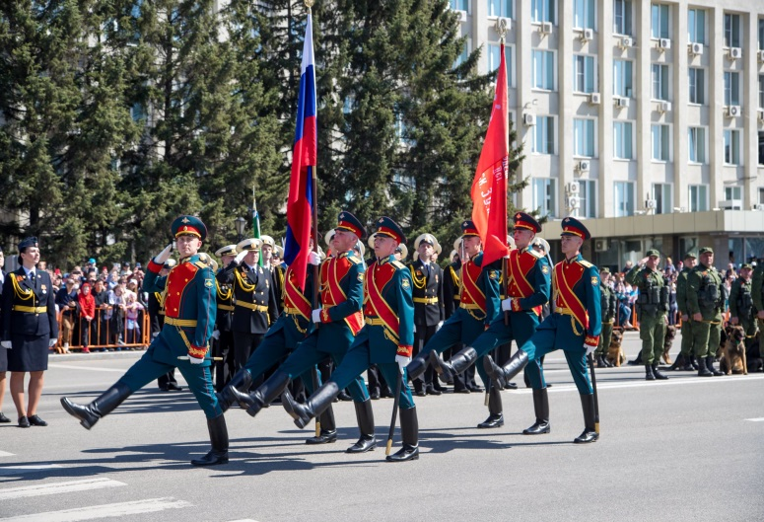
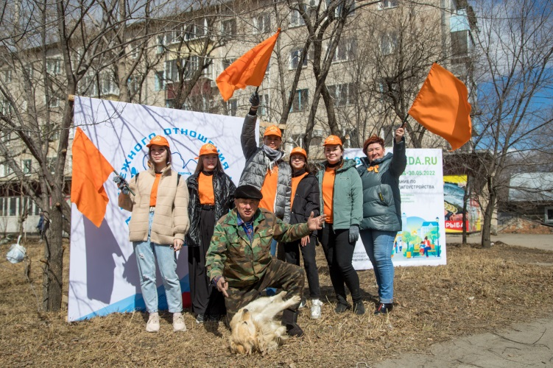

11

Slide 12
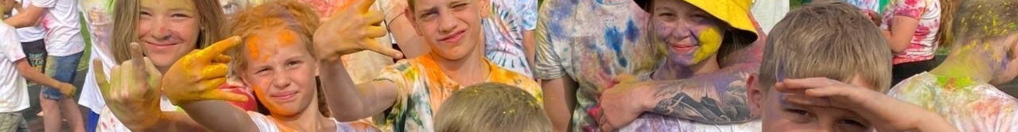
12
Population and labor resources
Population of the city of Blagoveshchensk
According to Rosstat, taking into account the results of the All-Russian Population Census of 2020 (01.10.2021), the permanent population of the city of Blagoveshchensk on 01.01.2023 is 245 244 people and in January-December 2022 decreased by 520 people. Or 0.2%. The average annual population for 2022 is 246 624 people.
The growth rate of the average annual population of the urban district of Blagoveshchensk for the period from 2014 to 2023, %
2020
Age and gender of the population of the city of Blagoveshchensk
52.8% of the city's population are women, 47.2% are men, respectively.
The average age of the population is 38 years old.
The working–age population is 162,8 thousand people.
As of 01.01.2024, 562 people were registered as unemployed in Blagoveshchensk in state institutions of the employment service.
The registered unemployment rate is 0.3% (of the working-age population).

Slide 13
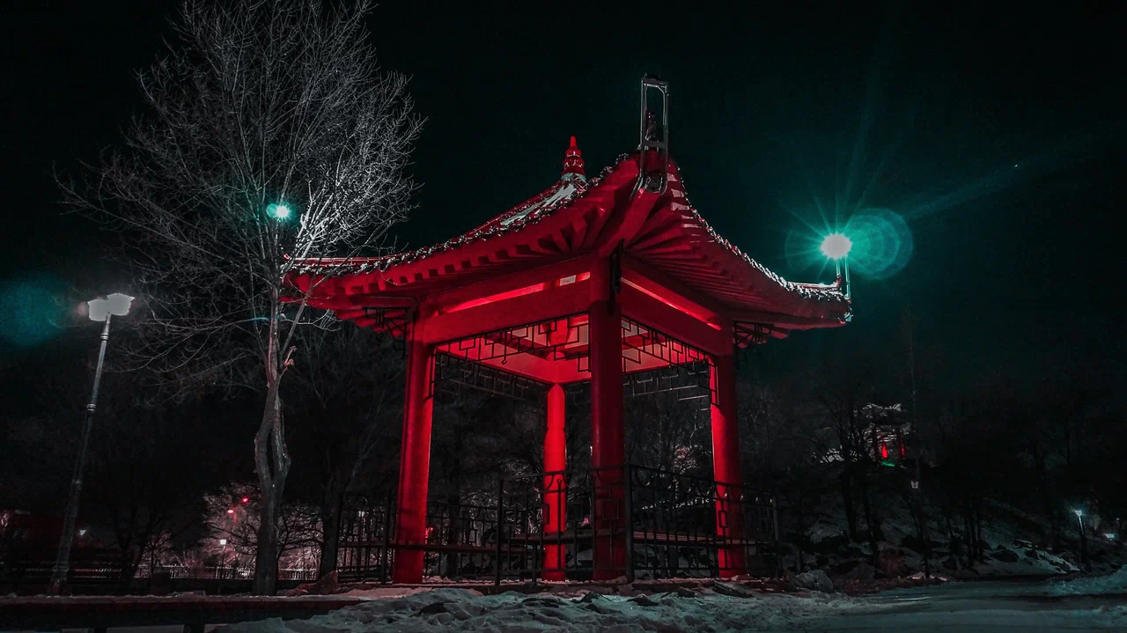
13

Slide 14
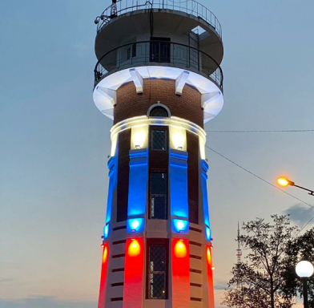
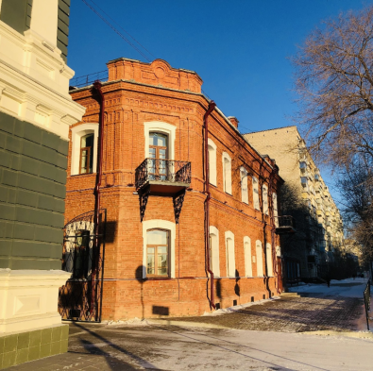
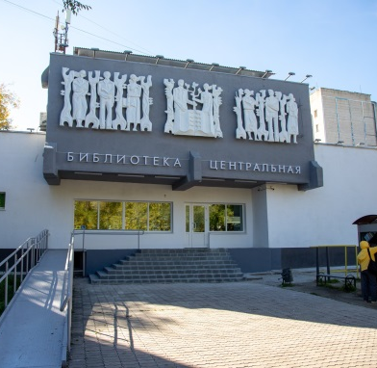
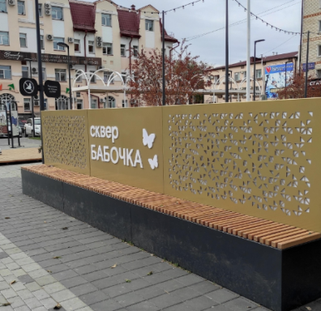
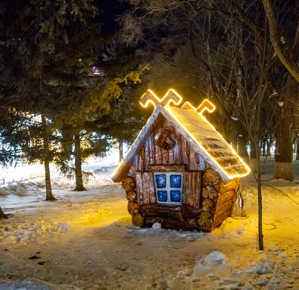
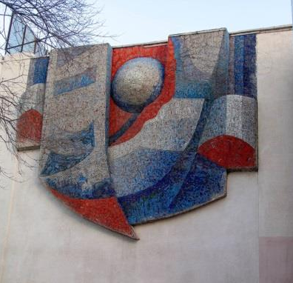
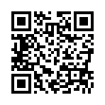
14
Tourism
The city of Blagoveshchensk possesses great tourism potential.
Tourist flow
A long history and unique attractions make the city attractive for the inbound tourism development. Here you can see: the oldest on the Far East Amur Regional Drama Theatre, Novikov-Daurskiy Amur Regional Museum, diocesan female school (now Amur Pedagogical College) which was opened in 1901 by a decree of the Holy Governing Synod, the first city public library founded in 1859, the marine college, operating since 1899 (now Amur branch of the Admiral G.I. Nevelskoy Maritime State University), Alekseevskaya female grammar school (now Municipal autonomous educational institution "Alekseevskaya Gymnasium of Blagoveshchensk"), which is operating since 1912.
99% foreign consumers of tourist services – Chinese tourists
Tour operators - 17
Tourist interest in Blagoveshchensk is represented by blocks of wooden buildings with allotment gardens of 19th century, brick buildings of the early 20th century, excavations of ancient pangolins, which are located in the city area.
Hotels and other accommodation facilities – 36
(number of rooms 1396)

Slide 15
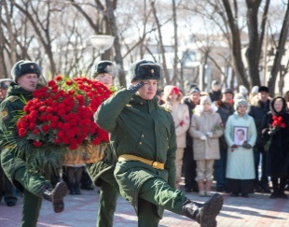
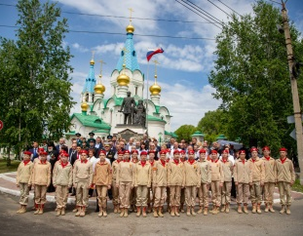
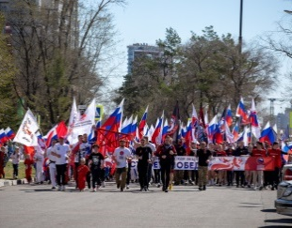
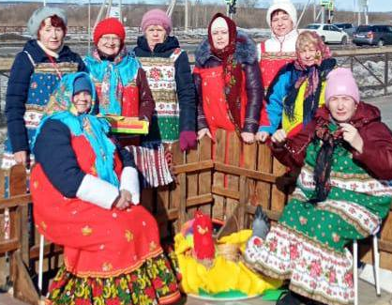
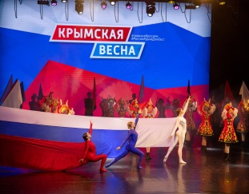
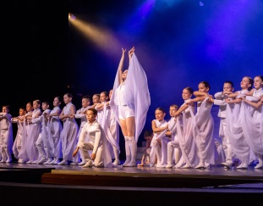
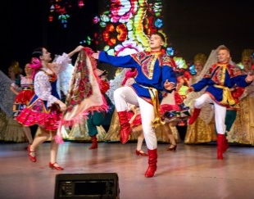
15
Tourism
Domestic tourism development is the priority direction of tourism, including business, event, culture and active tourism.
The city of Blagoveshchensk has a favorable geographical location, which creates all the prerequisites for the development of tourism. The Russian city of Blagoveshchensk in the Amur Region and the city of Heihe in the Heilongjiang province of China are the only pair of cities located on the border of the two states.
From May 26 to 28, 2023, the international exhibition and forum "Amurexpo-2024" was held in the territory of the city of Blagoveshchensk in the Social and Cultural Center. The forum consisted of business, cultural and sports events: round tables, exhibitions, plenary and visiting sessions, panel discussion, concerts, master classes by Russian and Chinese masters, a street sports festival, demonstrations of traditional Chinese martial arts – wushu. A stand of the Blagoveshchensk – Heihe Cross-border Agglomeration was presented by the administration of the city of Blagoveshchensk (RF) together with the city of Heihe (PRC).
On August 25-26, the international Russian-Chinese gastronomic festival "Shores of Taste" was held on the Amur River embankment. As part of the cultural and entertainment program, a series of events were held aimed at creating and popularizing the gastronomic brand of the region, training and conducting master classes for hospitality entrepreneurs.
A Tourism Department has been established in the Blagoveshchensk city administration.
In its activities to develop friendly and mutually beneficial economic and cultural ties with cities of foreign countries, Blagoveshchensk closely cooperates with the municipal authorities of Russian and foreign cities in the field of economics, education, culture.
International events are widely covered in the mass media, both in Blagoveshchensk and in our foreign partner cities, which helps to attract public attention to issues of strengthening international and twinning cooperation.

Slide 16
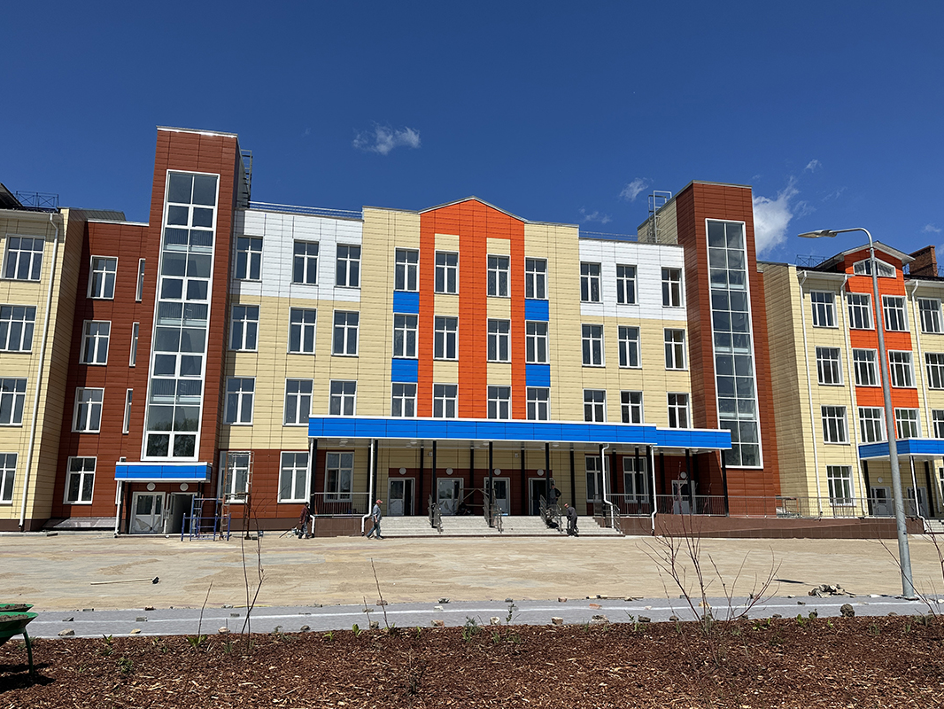
16

Slide 17
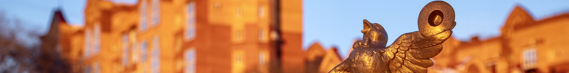
17
Social infrastructure
Education
Health service
Blagoveshchensk is one of the biggest centers of education and science of the Far East. It possesses huge labor force and intellectual potential.
On the territory of Blagoveshchensk there are 27 treatment and prevention institutions:
6
outpatient hospitals
6
hospitals
4
health facilities of a specific type
17
Pre-school educational institutions
21
Comprehensive institutions
1
blood transfusion station
1
ambulance
station
9
centers, sanatoriums, bureaus
13
Vocational education institutions
4
Universities
Culture
Physical Culture and Sport
118,6 thousand citizens do sport on a regular basis. Annually about 230 sport events are hold in the city.
On the territory of the city there are:
2 + 10 branches
cultural and leisure centers
3
Public amusement parks
5
Art schools for children
6 sport schools for the youth
Amur Regional Research and Children’s libraries,
Municipal information library system, which unites 12 libraries
Amur Regional Puppet Theatre,
Amur Regional Drama Theatre
612
sport facilities,
including:
89
gyms
6
swimming pools
3
stadiums with stands
Amur Regional concert hall
Novikov-Daurskiy Amur Regional Museum

Slide 18
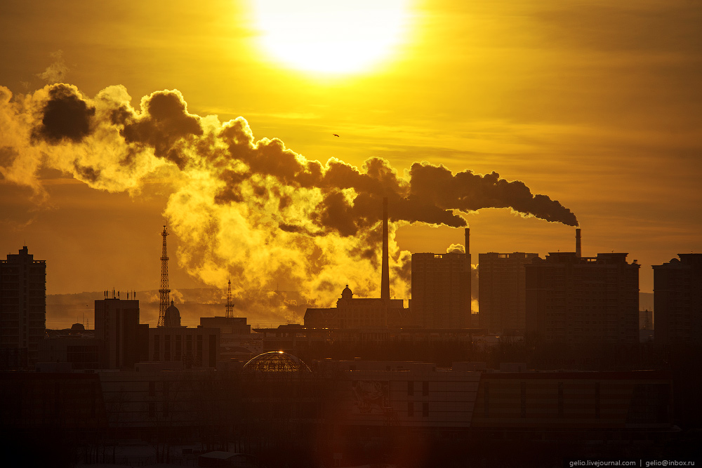
18

Slide 19
19
Economic potential
Economic and social indicators of development of Blagoveshchensk in 2023
Structure of fixed-capital investments (excluding SMEs). Types of economic activities, %
Turnover of organizations, which are not classified as small business enterprises (including medium-sized businesses) –
275 649,9 million rubles
Share of profitable enterprises (excluding small business enterprises) –
75,9%
Amount of new housing –
157,8 thousand square meters
Amount of “Building” sector –
17 773,4 million rubles
Retail trade turnover –
68 542,8 million rubles
Amount of paid services for citizens –
16 765,8 million rubles
Average nominal monthly wages (excluding small business enterprises) –
77 291,3 rubles
Amount of fixed-capital investments (excluding SBE).
Sources of funding, %
In the structure of investments in fixed assets, own funds account for 63.7%; attracted funds – 36.3%, of which budgetary funds – 75%, funds from extra–budgetary funds – 0.1%, others - 3.7%.
52 442,1 million rubles

Slide 20
20
Economic potential
The percentage of shipped products and the number of employees
by type of economic activity in 2023, %
Amount of shipped products
Amount of workers
125 381 million rubles
62,7 thousand people
Structure of manufacturing industry products
In Blagoveshchensk there are huge foodstuffs diversity (poultry meat, sausages, semi finished meat and meat-containing products, butter, whole milk products, confectionery and pasta), publishing and printing products, electrical equipment, various building materials and furniture.
26 694 million rubles

Slide 21
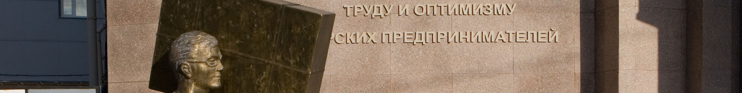
21
Economic potential
Small and medium enterprises (SME)
The structure of small business enterprises in types of economic activities
Total amount of small (including microenterprises) and medium enterprises (excluding sole trader) were 6545 units in 2023. There were 7529 sole traders in 01.01.2024.
The main share in total number of small and medium-sized businesses is:
Microenterprises
95%
Small business enterprises 4,8%
Medium-sized enterprises 0,2%
The amount of SME in the average number of employees of all enterprises and organizations of Blagoveshchensk is 70,1%.
Income from products realization (service provision)
180 526,9
million rubles
Tax revenue
19 416,2
million rubles
Support for SMEs
Support for SMEs on the territory of Blagoveshchensk city is realized within the framework of municipal program “SMEs and Tourism Development in Blagoveshchensk City Area”, which includes “SMEs Development in Blagoveshchensk City” subprogram. This was approved by decree (03.10.2014 № 4129) of Blagoveshchensk city administration.
Support for SMEs includes financial, property, informational, consulting and organizational support services.

Slide 22
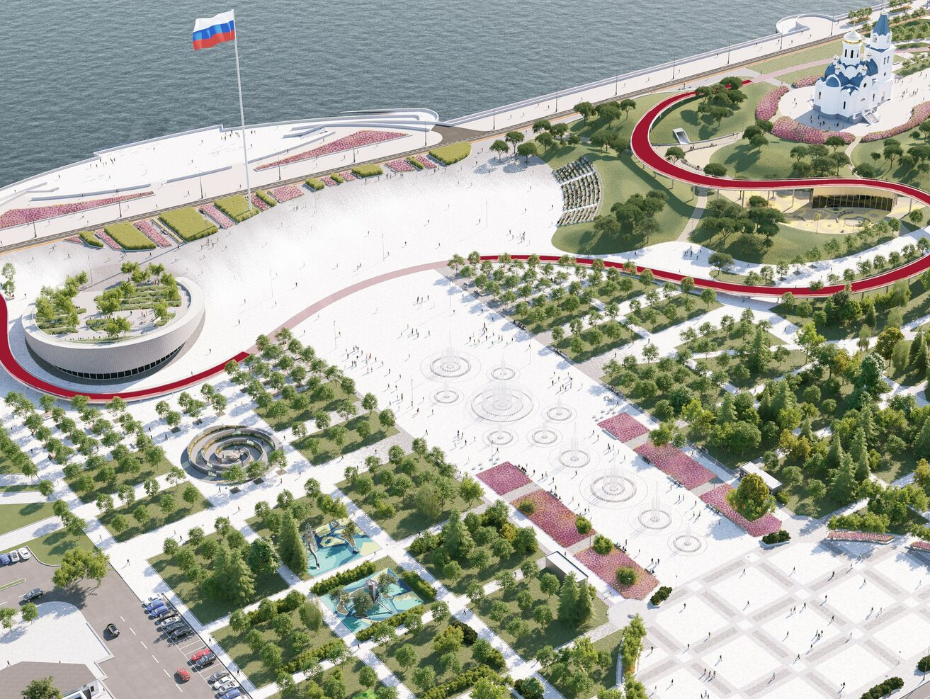
22

Slide 23
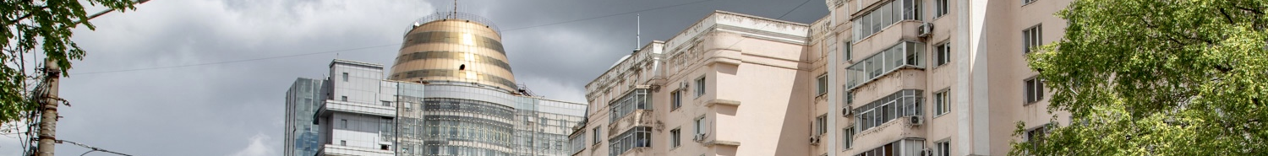
23
Investment attractiveness
Competitive advantages
Modern development institutes
Regional and municipal institutions, institutes of modern development are located on the territory of Blagoveshchensk:
Business and Investment Support Center "My Business"
Agency of the Amur Region for Attracting Investments
Credit assistance fund of SME of Amur region
Council of improving investment climate and developing entrepreneurship under the lead of the mayor of Blagoveshchensk
Amur Regional Microcredit Company
Blagoveshchensk city Multifunctional center of providing state and municipal services
Amur Regional Chamber of Industry and Commerce, OPORA Russia, Business Russia, Industrialists, Entrepreneurs and Employers Union of the Amur Region, institute authorized to protect the rights of entrepreneurs and many others are all-Russian organizations which represent small business enterprises.
Individual approach to investors
Equal treatment for domestic and foreign investors
Complete project support in the "one stop" regime
Scale
Blagoveshchensk is the administrative center of Amur region. Population — 245,6 thousand people. It is the sixth biggest city in the Far East.
Advantageous geographical location
The city is located on the left bank of the Amur river and on the right one of the Zeya river. It is the only one among other regional centers of the Russian Federation which is located on the state border. Chinese city of Heihe is on the right bank of the Amur river. There is a railway which provides railway junction with the Trans-Siberian Railway.
Developed education system
The city has the developed system of colleges, universities and research institutuons.
Developed business infrastructure
In Blagoveshchensk there are: 23 credit organizations, 13 insurance organizations, 13 leasing companies; consulting, advertising and employment agencies; audit firms.
City attractiveness
Blagoveshchensk has the developed real estate and consumer market, high availability of medical organizations and institutions of health, education and culture.
Resources
There is the resource base for enterprises which work in sphere of producing building materials and food products.
“Growth points” of the city of Blagoveshchensk
Tourism and recreation
Logistics and connection
Processing industry

Slide 24
24
State and municipal support of investment activity
State support of investment activity
Municipal support of investment activity
Tax preferences
Establishment of differentiated tax rates for corporate property tax of certain taxpayers' categories;
Establishment of reduced profit taxes, which should be entered in Amur region budget at the rate of 13,5% for certain taxpayers' categories;
Establishment of profit tax rates, which should be entered in Amur region budget. During the first five tax periods - 0%, during the next five tax periods - 10% for projects, which have "Regional investment project" status according to the Federal Law 30.09.2013 № 267-FL;
Establishment of differentiated tax rates in using simplified taxation system.
Establishment of zero tax rate in using simplified taxation system during the first two tax periods for taxpayers – sole traders, who are for the first time registered and who carry out various types of activities;
Establishment of tax rate in the amount of 0% in using patent taxation system during the first two tax periods for taxpayers – sole traders, who are for the first time registered and who carry out various types of activities;
Providing the investment tax credit;
Deferral or installment in paying regional taxes.
Lands, buildings, structures owned by Amur region are available for rent on preferential terms.
Provision of guarantees on obligations (credit, loan) non-commercial organization «Assistance lending fund for SME»
Microloan provision (ANO “Amur Regional Microcredit Company”)
Non-financial support measures
Complete project support in the “one stop” regime - ANO "Agency of the Amur Region for Attracting Investments“
Marketing, informational, law support for SMEs activities, organization of training courses by Enterprise support center, Cluster development center, Export support center of Amur region.
Municipal guarantees for legal entity carrying out economic activity on the territory of the city;
Providing sites of Blagoveshchensk for investment projects realization according to the main strategic directions of the city development;
Provision of a 98% discount on rent for land plots;
Property support in renting municipal properties that are free from any right or claim of a third party (excluding property rights of SME);
Organizational, informational, consulting support;
Support for SME:
Subsidies program of part of the costs associated with the payment of the first installment (advance payment) at the conclusion of equipment leasing agreements
Subsidies program of part of the costs associated with the purchase of equipment for the creation/development/modernization of production
part of the costs of the purchase, repair of non-residential premises, as well as the purchase of building materials.
Non-financial support measures:
Council of improving investment climate and developing entrepreneurship under the lead of the mayor of Blagoveshchensk;
Investment projects support in the “one stop” regime by economic and investment development authority of Blagoveshchensk city administration;
Introduction of work standard in order to improve investment climate of Blagoveshchensk;
Inclusion of investment projects in municipal programs according to budget law of The Russian Federation.

Slide 25
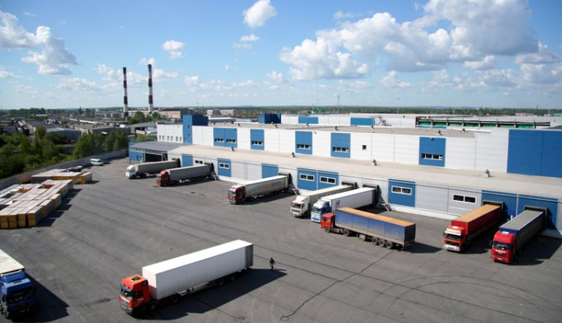
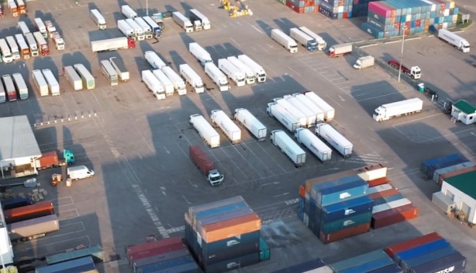

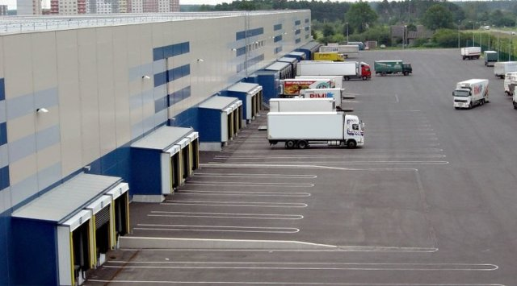
25
Construction of a modern transport and logistics terminal in Blagoveshchensk with a cargo handling volume of over 300,000 tons*
Project initiator, contact information | Dispatcher LLC, TIN 2801157631, 101/2 Tenistaya street, Blagoveshchensk, e-mail: mail@artk.ru.
Project goal, capacity/available documentation | Improving the quality, increasing the quantity and volume of transport and logistics services provided for organizations, enterprises and the population of the Amur region. Cargo handling volume of over 300,000 tons.
Project implementation timeline | Years 2022 – 2033
Project value/required investments, Rub mln. | 2 391,46
Investment attraction form | Investor funds, third-party investments, loan
Project degree of readiness, provision with raw materials, land, resources | Preparatory phase. Included in the list of priority investment projects of the region (PIP). PIP State support measures.
* in accordance with the order of the Government of the Amur Region dated 08.08.2011 No. 90-r (as amended. from 12/26/2023)

Slide 26
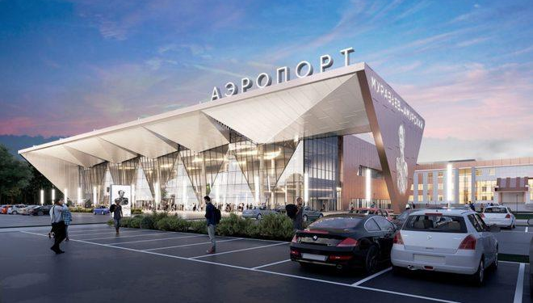
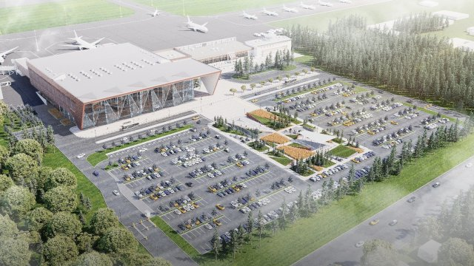
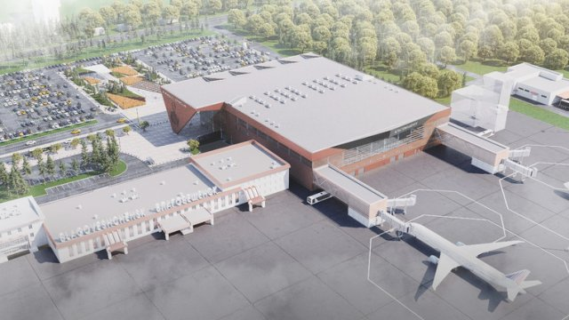
26
Creation, reconstruction, modernization and operation of infrastructure facilities of Blagoveshchensk International Airport (Ignatievo) for servicing international and domestic airlines*
Project initiator, contact information | ABS Blagoveshchensk LLC, INN 9705142240, Room No. 25, 6 floor, 26 Valovaya str., Moscow
Project goal, capacity/available documentation | Construction of a new airport complex with a capacity of 600 passengers/hour, reconstruction of the existing terminal.
Project implementation timeline | Years 2021 – 2026
Project value/required investments, Rub mln. | 8 052,00
Investment attraction form | Budgetary funds and investor funds (PPP)
Project degree of readiness, provision with raw materials, land, resources | Preparatory phase. It is necessary to create/reconstruct engineering infrastructure facilities (technological connection). Included in the list of priority investment projects of the region (PIP). PIP State support measures. Resident of ASEZ “Amurskaya” .
* in accordance with the order of the Government of the Amur Region dated 08.08.2011 No. 90-r (as amended. from 12/26/2023)

Slide 27
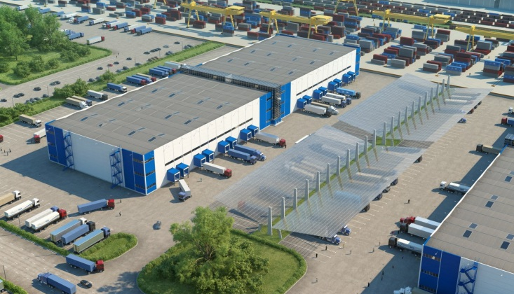
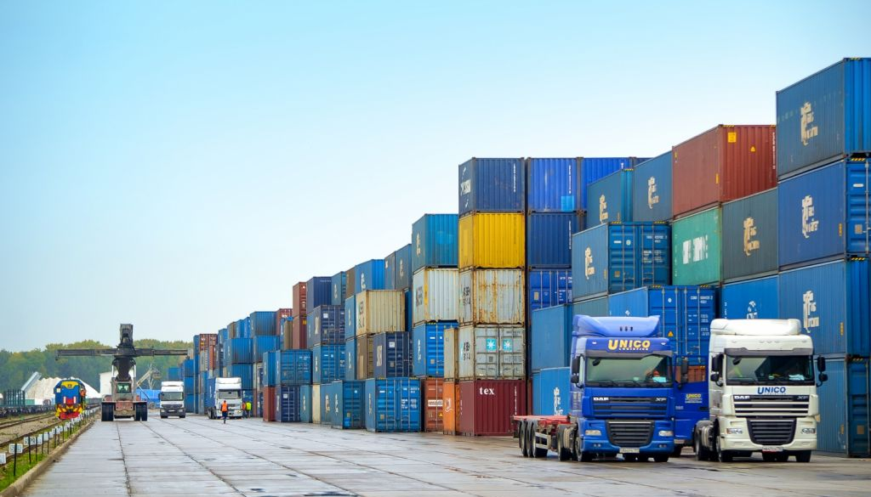
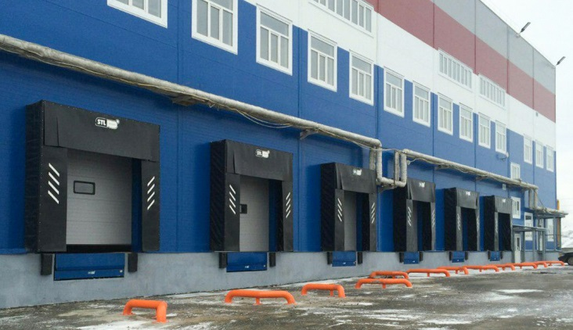
27
Construction of transport and logistics hub in the city of Blagoveshchensk*
Project initiator, contact information | LLC “Cargo Link”, INN 2801207307, 20 Magistralnaya Str., city of Blagoveshchensk.
Project goal, capacity/available documentation | Construction of transport and logistics hub in the city of Blagoveshchensk, with capacity of: cargo handling – 1,440 railcars per year, warehousing – 5,200 tones, handling works – 74,880 tons per year.
Project implementation timeline | Years 2023 – 2029
Project value/required investments, Rub mln. | 506,07
Investment attraction form | Investor funds, borrowed funds
Project degree of readiness, provision with raw materials, land, resources | Preparatory phase. Included in the list of priority investment projects of the region (PIP). PIP State support measures. By Order of the Governor of the AR of 12.09.2023 No. 209-r is acknowledged as a large-scale investment project.
* in accordance with the order of the Government of the Amur Region dated 08.08.2011 No. 90-r (as amended. from 12/26/2023)

Slide 28



28
The cross-border cable car construction across the Amur river between Blagoveshchensk (Russia) – Heihe (China)*
Project initiator, contact information | ZED Development LLC, INN 7727797889, 50 Krasnoflotskaya street, Blagoveshchensk
Project goal, capacity/available documentation | Creation of an international year-round transport corridor, capacity – 457 people / hour, 1034 thousand people / year (in the direction of departure and arrival).
Project implementation timeline | Years 2019 – 2025
Project value/required investments, Rub mln. | 13 252,00
Investment attraction form | Holding's funds
Project degree of readiness, provision with raw materials, land, resources | Preparatory phase. Included in the list of priority investment projects of the region (PIP). PIP State support measures.
* in accordance with the order of the Government of the Amur Region dated 08.08.2011 No. 90-r (as amended. from 12/26/2023)

Slide 29



29
Housing development of “Severny residential district” of the city of Blagoveshchensk *
Project initiator, contact information | Administration of the city of Blagoveshchensk, 133 Lenin Str., Blagoveshchensk, tel. 8 (4162) 233-714.
Project goal, capacity/available documentation | Construction of a residential micro-district of the area of 237 ha and total residential area of 1,7 mln. sq m. The Project will allow for providing 1,778 thousand sq m. of housing, opening 3,980 study places in schooling institutions, arranging 8,840 study places for the students of sport schools.
Project implementation timeline | Years 2007 – 2030
Project value/required investments, Rub mln. | 98,797.00
Investment attraction form | Budgetary funds
Project degree of readiness, provision with raw materials, land, resources | Under implementation. Ongoing engineering infrastructure and housing construction, front-end engineering design of the social infrastructure construction. Included in the list of priority investment projects of the region (PIP). PIP State support measures.
* in accordance with the order of the Government of the Amur Region dated 08.08.2011 No. 90-r (as amended. from 12/26/2023)

Slide 30



30
Construction of “Severny residential district” *
Project initiator, contact information | Specialized Developer PIK Blagoveshchensk LLC, INN 2801265933 503 office, 136 Zeyskaya str., Blagoveshchensk, Amur Region, 675029, tel. 8 (914) 152-70-00
Project goal, capacity/available documentation | Building area – 30,0 hectares, housing area – 178 thousand square meters , residents - 10 120 people.
Project implementation timeline | Years 2022 – 2029
Project value/required investments, Rub mln. | 15 792,00
Investment attraction form | Project financing, investor funds
Project degree of readiness, provision with raw materials, land, resources | Preparatory phase. Included in the list of priority investment projects of the region (PIP). PIP State support measures. By Order of the Governor of the AR of 16.08.2022 No. 178-r is acknowledged as a large-scale investment project. Resident of ASEZ “Amurskaya”.
* in accordance with the order of the Government of the Amur Region dated 08.08.2011 No. 90-r (as amended. from 12/26/2023)

Slide 31



31
Construction of capital facilities intended for residential accommodation *
Project initiator, contact information | LLC “SZ “PIK Blagoveshchensk”, INN 2801265933 120 Mukhin Str., premises/office 20002/213, Blagoveshchensk, Amur Oblast, 675029,
Project goal, capacity/available documentation | The Project will allow for providing accommodation for the inhabitants of the city of Blagoveshchensk. Land plot area – 912,075 sq m. Housing area – 334 180 sq m. Non-residential premises area – 16,700 sq m.
Project implementation timeline | Years 2023 – 2036
Project value/required investments, Rub mln. | 33 898,00
Investment attraction form | Investor funds, C
Project degree of readiness, provision with raw materials, land, resources | Preparatory phase. Included in the list of priority investment projects of the region (PIP). PIP State support measures. By Order of the Governor of the AR of 16.08.2022 No. 178-r is acknowledged as a large-scale investment project. Resident of ASEZ “Amurskaya”.
* in accordance with the order of the Government of the Amur Region dated 08.08.2011 No. 90-r (as amended. from 12/26/2023)

Slide 32



32
Development of the territory in the area of the Plodopitomnik village of the municipality of Blagoveshchensk "Ignatievskaya manor"*
Project initiator, contact information | “Bureyazhilpromstroy” LLC, INN 2801096964, 159/1 Polytechnic Str., Blagoveshchensk, tel. 8 (4162) 420-254, e-mail: 8416242054@mail.ru
Project goal, capacity/available documentation | Comprehensive development of the territory through housing construction and tourism facilities. Building area – 402 hectares. Housing area – 338 thousand sq m. Residents – 13,2 thousand people. It is planned to build social infrastructure facilities (with an area of 12.32 hectares): 4 schools for 1,974 places (8.63 hectares); 6 kindergartens for 700 places (3.69 hectares).
Project implementation timeline | Years 2010 – 2020
Project value/required investments, Rub mln. | 11 982,00
Investment attraction form | Investor funds, third-party investments
Project degree of readiness, provision with raw materials, land, resources | Preparatory phase. Low-rise buildings and construction of engineering infrastructure facilities are in the process of building. Search for investors. Included in the list of priority investment projects of the region (PIP). PIP State support measures.
* in accordance with the order of the Government of the Amur Region dated 08.08.2011 No. 90-r (as amended. from 12/26/2023)

Slide 33



33
Modernization and reconstruction of the Blagoveshchensk Building Materials Factory (3rd stage)*
Project initiator, contact information | Blagoveshchensk Building Materials Factory LLC, tel. 8 (4162) 338-238, e-mail: bzsm100@yandex.ru.
Project goal, capacity/available documentation | Modernization of silicate brick production technology, including in order to improve product quality, purchase of equipment for production. Design capacity: silicate brick – 131 million pieces per year
Project implementation timeline | Years 2018 – 2025
Project value/required investments, Rub mln. | 224,36
Investment attraction form | Investor funds, third-party investments
Project degree of readiness, provision with raw materials, land, resources | Preparatory phase. Included in the list of priority investment projects of the region (PIP). PIP State support measures.
* in accordance with the order of the Government of the Amur Region dated 08.08.2011 No. 90-r (as amended. from 12/26/2023)

Slide 34



34
Plant for the production of aerated concrete products of the Amur region, the city of Blagoveshchensk*
Project initiator, contact information | Blagoveshchensk GBZ LLC, 10 Zavodskaya str., Belogorye village, Blagoveshchensk, tel. 8 (4162) 209-991, e-mail: ukbh@yandex.ru.
Project goal, capacity/available documentation | An increase of the production of aerated concrete blocks and slabs and, as a result, an increase of profits while selling blocks and slabs on the construction materials market Aerated concrete blocks – 90 thousand cubic meters, aerated concrete pipes – 30 thousand cubic meters per year
Project implementation timeline | Years 2013 – 2020
Project value/required investments, Rub mln. | 631,73
Investment attraction form | Investor funds, third-party investments
Project degree of readiness, provision with raw materials, land, resources | Preparatory phase. Included in the list of priority investment projects of the region (PIP). PIP State support measures.
* in accordance with the order of the Government of the Amur Region dated 08.08.2011 No. 90-r (as amended. from 12/26/2023)

Slide 35



35
Construction and operation of a plant for the production of tempered, fire-resistant and laminated glass, as well as architectural double-glazed windows for facade glazing *
Project initiator, contact information | Home Master Glass LLC, TIN 2801266944, 12a Energeticheskaya street, Blagoveshchensk
Project goal, capacity/available documentation | Construction and operation of a plant for the production of tempered fire-resistant and laminated glass, as well as architectural double-glazed windows for facade glazing, with a capacity of 235 thousand square meters of translucent structures per year.
Project implementation timeline | Years 2023 – 2027
Project value/required investments, Rub mln. | 348,05
Investment attraction form | Investor funds
Project degree of readiness, provision with raw materials, land, resources | Preparatory phase. Included in the list of priority investment projects of the region (PIP). PIP State support measures. By Order of the Governor of the AR of 02.11.2022 No. 257-r is acknowledged as a large-scale investment project. Resident of ASEZ “Amurskaya”. The schedule of the investment project has been approved.
* in accordance with the order of the Government of the Amur Region dated 08.08.2011 No. 90-r (as amended. from 12/26/2023)

Slide 36



36
Construction and operation of multiservice complex with sport and culture facilities in Blagoveshchensk*
Project initiator, contact information | LLC “Mildor Development”, INN 2801253078, 115 Lenin Str., floor 2, office 11, city of Blagoveshchensk
Project goal, capacity/available documentation | Creation of multiservice complex with sport and culture facilities on the “Golden mile” of the area of 40 thousand sq m.
Project implementation timeline | Years 2020 – 2023
Project value/required investments, Rub mln. | 1 079,00
Investment attraction form | Investor funds
Project degree of readiness, provision with raw materials, land, resources | Under implementation. Developed technical and economic feasibility study. Included in the list of priority investment projects of the region (PIP). PIP State support measures. By Order of the Governor of the AR of 30.07.2020 No. 173-r is acknowledged as a large-scale investment project.
* in accordance with the order of the Government of the Amur Region dated 08.08.2011 No. 90-r (as amended. from 12/26/2023)

Slide 37



37
Construction and operation of 4 Star hotel complex on the “Golden mile” plot in Blagoveshchensk *
Project initiator, contact information | LLC “Mildor Development”, INN 2801253078, 115 Lenin Str., floor 2, office 11, city of Blagoveshchensk
Project goal, capacity/available documentation | Construction of a 4* hotel complex for 135 rooms.
Project implementation timeline | Years 2020 – 2026
Project value/required investments, Rub mln. | 3 289,00
Investment attraction form | Investor funds
Project degree of readiness, provision with raw materials, land, resources | Under implementation. Developed technical and economic feasibility study. Included in the list of priority investment projects of the region (PIP). PIP State support measures. By Order of the Governor of the AR of 30.07.2020 No. 172-r is acknowledged as a large-scale investment project.
* in accordance with the order of the Government of the Amur Region dated 08.08.2011 No. 90-r (as amended. from 12/26/2023)

Slide 38



38
Construction of recreation cluster: hot baths, food-mall, SEC, hotel complex («Blagoveshchensk hot baths» project) *
Project initiator, contact information | LLC “Specialized Developer Art-stroy”, INN 2801158868, 118 Tekstilnaya Str., Letter A5, room 3, city of Blagoveshchensk, tel 8 (909) 894-46-36, e-mail: dag700@yandex.ru
Project goal, capacity/available documentation | For construction are planned the following facilities of recreation cluster: City hot baths – 5 000 sq m.; Shopping and entertainment center (SEC) – 21 500 sq m.; Food mall – 3 000 sq m.; Hotel complex – 4 100 sq m.
Project implementation timeline | Years 2024 – 2029
Project value/required investments, Rub mln. | 3,967,01
Investment attraction form | Own funds, borrowed funds
Project degree of readiness, provision with raw materials, land, resources | Preparatory phase. Included in the list of priority investment projects of the region (PIP). PIP State support measures. Cadastral survey conducted in the territory of ward 444, cadastral registration of land plots, state registration of municipal property rights.
* in accordance with the order of the Government of the Amur Region dated 08.08.2011 No. 90-r (as amended. from 12/26/2023)

Slide 39



39
Comprehensive school for 1,200 study places in the “Severny” planning district, Blagoveshchensk, the Amur Region *
Project initiator, contact information | LLC “PIK education projects – Blagoveshchensk”
Project goal, capacity/available documentation | Construction of comprehensive school for 1,200 study places.
Project implementation timeline | Years 2023 – 2024
Project value/required investments, Rub mln. | 1 714,80
Investment attraction form | -
Project degree of readiness, provision with raw materials, land, resources | Preparatory phase. Included in the list of priority investment projects of the region (PIP). PIP State support measures.
* in accordance with the order of the Government of the Amur Region dated 08.08.2011 No. 90-r (as amended. from 12/26/2023)

Slide 40



40
Construction of “I can feel” Sensory Park
Project initiator, contact information | LLC “Argument”, INN 2801107775, 156/2 Zeyskaya Str., office 403, Blagoveshchensk, tel. 89145539900
Project goal, capacity/available documentation | Creation of social and cultural facility – “I can feel” sensory park on the land plot with cadastral number 28:01:110137:1, and the area of 22,11 ha.
Project implementation timeline | Years 2021 – 2027
Project value/required investments, Rub mln. | 116,50
Investment attraction form | Investor funds, loan
Project degree of readiness, provision with raw materials, land, resources | Under implementation. Concluded trilateral liaison agreement in connection with the construction of social and cultural facility on land plots leasable without bidding of 22.06.2021 No.188, land plots leased without bidding.

Slide 41



41
Complex housing development in ward 404 of the city of Blagoveshchensk
Project initiator, contact information | JSC SZ “Amurstroi”, INN 2801005205, 1 Svyatitelya Innokentiya lane, city of Blagoveshchensk tel. 8 (4162) 20-03-16.
Project goal, capacity/available documentation | Planned construction of 11 multiple dwelling houses for 952 apartments of total living floor space of 42,8 thousand sq m (9, 10 and 14 storeys).
Project implementation timeline | Years 2021 – 2025
Project value/required investments, Rub mln. | 2 449,28
Investment attraction form | Investor funds
Project degree of readiness, provision with raw materials, land, resources | Under implementation. By Order of the Governor of the AR of 28.02.2018 No. 13-r is acknowledged as a large-scale investment project.

Slide 42



42
Grand city center "Tribune Hall", Blagoveshchensk, Amur region
Project initiator, contact information | Administration of the city of Blagoveshchensk, 133 Lenin Str., Blagoveshchensk, tel. 8 (4162) 233-714
Project goal, capacity/available documentation | Reconstruction and improvement of the existing Lenin Square and its smooth transition to the alluvial area. Placement of a cultural center with a tribune, which will become a universal structure and can be used as an observation deck, a tribune for spectators, etc.
Project implementation timeline | Years 2020 – 2024
Project value/required investments, Rub mln. | 2 151,45
Investment attraction form | Budgetary funds
Project degree of readiness, provision with raw materials, land, resources | Under implementation. The construction of the facilities provided for in the framework of the project is underway.

Slide 43



43
Concession agreement in respect of outdoor lighting facilities owned by the city of Blagoveshchensk
Project initiator, contact information | LLC “SLS Blagoveshchensk”, INN 2801256720, 115 Lenin Str., floor 2, office, city of Blagoveshchensk 11
Project goal, capacity/available documentation | Upgrade of poles, replacement of ineffective lighting equipment, arrangement of architectural illumination of buildings and structures, arrangement of cable conduits, upgrade and arrangement of control system equipped with Automated Outdoor Lighting Control System.
Project implementation timeline | Years 2021 – 2036
Project value/required investments, Rub mln. | 1 168,12
Investment attraction form | Investor funds
Project degree of readiness, provision with raw materials, land, resources | Under implementation. Concessionary.

Slide 44



44
Concession agreement in respect of centralized cold-water supply and wastewater systems, individual facilities of such systems of the municipality of the city of Blagoveshchensk
Project initiator, contact information | LLC “Amur communal systems”, INN 2801254956, 73 Mukhin Str., city of Blagoveshchensk
Project goal, capacity/available documentation | Work with centralized cold-water supply and wastewater systems, and individual facilities of such systems.
Project implementation timeline | Years 2022 – 2050
Project value/required investments, Rub mln. | 13 826,80
Investment attraction form | Investor funds, budgetary funds
Project degree of readiness, provision with raw materials, land, resources | Under implementation. Concessionary.

Slide 45



45
Construction of added-value wood processing complex – for the production of dihydroquercetin and arabinogalactan substances
Project initiator, contact information | LLC “Ametis-Farm”, INN: 2801176666, 68 Naberezhnaya Str., city of Blagoveshchensk, Amur Oblast
Project goal, capacity/available documentation | Construction of the plant for production of building materials of total max. capacity up to 12,000 cubic m per year.
Project implementation timeline | Years 2024 – 2025
Project value/required investments, Rub mln. | 150,78
Investment attraction form | Investor funds, budgetary funds
Project degree of readiness, provision with raw materials, land, resources | Under implementation. Property support. Resident of ASEZ “Amurskaya”

Slide 46

46
Legal regulation of investment and business activities
Federal Law № 39-FZ of February 25, 1999 “On Investment Activities In The Russian Federation, Realizing In The Form Of Capital Investment”
Federal Law № 160-FZ of July 09, 1999 “On Foreign Investment In The Russian Federation”
Federal Law № 224-FZ of July 13, 2015 “On A Public–Private Partnership In The Russian Federation and On Amendment Of Legislation Of The Russian Federation”
Federal Law № 209-FZ of July 24, 2007 “On Developing SME In The Russian Federation”
«The Land Code of The Russian Federation» № 136-FZ of October 25, 2001 (paragraph 39.6 “Cases Of Granting Land Plots For Rent Through Bidding or Without It, Which Are Owned By State or Municipal Government”)
«Town Planning Code of The Russian Federation» № 190-FZ of December 29, 2004 (part 2 paragraph 51 “Planning Permission”)
Amur Region Law № 374-OZ of September 05, 2007 “On Investment Activities In The Amur Region”
Amur Region Law № 298-OZ of January 11, 2010 “On Supporting and Developing SME In The Amur Region”
Amur Region Law № 389-OZ of October 04, 2010 “On Reduced Income Tax Rates”
Amur Region Law № 266-OZ of November 28, 2003 “On Corporate Property Tax In The Amur Region”
Amur region law #321-OZ of February 14, 2014 “On the Implementation of Certain Provisions of the Tax Code of the Russian Federation regarding the implementation of regional investment projects"
Amur region law № 528-OZ of May 5, 2015 “On the establishment of a zero tax rate levied in connection with the application of the simplified taxation system for taxpayers - individual entrepreneurs“
Amur region law № 93-OZ of October 9, 2012 “On the patent system of taxation in the Amur region”
Decree of the Government of the Russian Federation № 141 of February 9, 2021 “On Approval of the Rules for Granting Subsidies from the Federal Budget to Russian Credit Organizations and the State Development Corporation "VEB.RF“ on compensation of the income they have not received on loans issued at a preferential rate to investors for the implementation of investment projects necessary for the sustainable development of domestic and inbound tourism, and on amendments to the regulations on the Government Commission for the development of Tourism in the Russian Federation“
Decree of the Government of the Russian Federation № 1704 of October 19, 2020 "On Approval of the Rules for Determining New Investment Projects for the Implementation of which the Budget Funds of the Subject of the Russian Federation Released as a Result of a Decrease in the Volume of Repayment of the Debt of the Subject of the Russian Federation to the Russian Federation on budget loans are subject to direction for the Implementation by the Subject of the Russian Federation of budget investments in infrastructure facilities“
Decree of the Government of the Russian Federation № 1740 of October 12, 2021 "On Approval of the Rules for Writing off the Debt of a Subject of the Russian Federation to the Russian Federation on Budget Loans, Methods for Calculating the Receipt of Tax Revenues to the Federal Budget from the Implementation of New Investment Projects, in the amount of receipts to the Federal Budget of which the Government of the Russian Federation has the right to write off the debt of Subjects of the Russian Federation on budget loans, and on invalidation of the Decree of the Government of the Russian Federation No. 1705 dated 19.10.2020"

Slide 47
47
Legal regulation of investment and business activities
Decree of the Governor of the Amur region № 217 of April 4, 2011 “On approval of the procedure for forming a list of priority investment projects"
Decree of the Government of Amur Region № 186 of April 18, 2013 № 186 “On organization of work on providing tax incentives”
Decree of the Government of Amur Region #697 of November 19, 2014 “On Investment Projects Support In The “One Stop” Regime”
Decree of the Government of Amur Region № 423 of July 1, 2021 “On Approval of the Procedure for Granting Subsidies to Legal Entities for Reimbursement of Part of the Costs of Connecting (Technological Connection) Capital Construction Facilities to the Electrical Networks of Engineering and Technical Support for the Implementation of Priority Investment Projects of the Amur Region Coordinated by the Ministry of Economic Development and External Relations of the Amur Region in accordance with the Order of the Government of the Amur Region dated 08.08.2011 No. 90-p "On approval of the list of priority investment projects of the Amur Region" “
Decree of the Government of Amur Region № 796 of October 13, 2021 "On approval of the Procedure for granting subsidies from the regional budget for reimbursement of part of the costs in connection with the implementation of priority investment projects of the Amur Region“
Resolution of the Blagoveshchensk city Duma № 16/80 of September 24, 2020 "On property support for small and medium-sized businesses“
Resolution of the Blagoveshchensk city Duma № 34/114 of October 25, 2007 “On Land Plots Payment, Which Are Owned By Municipal Division Of Blagoveshchensk City”
Resolution of the Blagoveshchensk city Duma № 4/27 of November 27, 2014 “On Mortgage Fund Of Municipal Division Of Blagoveshchensk City”
Resolution of the Blagoveshchensk city Duma № 51/128 of December 20, 2018 “The Socio-economic Development Strategy of the Municipality of Blagoveshchensk for the Period until 2025”
Resolution of the Blagoveshchensk city Duma № 6/51 of December 24, 2019 “On Amendments to the strategy of socio-economic development of the Municipality of Blagoveshchensk for the period up to 2025, approved by the resolution of the Blagoveshchensk City Duma of December 20, 2018 No. 51/128”
Decree of the Mayor of Blagoveshchensk city № 20 of June 30, 2016 “On Determination Of The Local Government Of Municipal Division For The Exercise Of Powers In The Municipal-Private Partnership Sphere”
Decree of Blagoveshchensk city administration № 4387 of December, 2019 «On the implementation of certain provisions of the legislation on concession agreements, municipal-private partnership in the territory of the municipal formation of the city of Blagoveshchensk»
Decree of the Blagoveshchensk city administration № 4387 of December 20, 2019 “On the Implementation of Certain Provisions of the Legislation on Concession Agreements, Municipal-Private Partnership in the Territory of the Municipal Formation of the City of Blagoveshchensk“
Decree of Blagoveshchensk city administration № 4129 of October 03, 2014 “SMEs and Tourism Development in Blagoveshchensk Town Area”
Decree of Blagoveshchensk city administration № 1197 of April 24, 2017 “On Approval Of Investment Strategy Of Municipal Division to 2025”

Slide 48
48
Legal regulation of investment and business activities
Decree of Blagoveshchensk city administration № 3484 of September 15, 2015 “On Regulatory Impact Assessment Of Municipal Law’s Projects And Legal Evaluation Of Municipal Law, Concerning Business And Investment Activities”
Decree of Blagoveshchensk city administration № 2691 of July 17, 2015 «On Approval Of Investment Projects Support In The “One Stop” Regime On The Territory Of Blagoveshchensk City”
Decree of Blagoveshchensk city administration № 3040 of September 11, 2017 “On Creating The Council For Improving Investment Climate and Developing Entrepreneurship Under The Blagoveshchensk City Mayor”
Decree of Blagoveshchensk city administration № 2415 of June 25, 2015 “On Approval of The Administrative Regulation of Blagoveshchensk City “Realization Of The Buy-Out Offer For Municipal Property Owned by The Municipal Division Of Blagoveshchensk City and Leased by SME”
Decree of Blagoveshchensk city administration № 266 of February 02, 2017 “On Regulation’s Approval About Guarantees Of Municipal Division Of Blagoveshchensk City”
Decree of Blagoveshchensk city administration № 1066 of March 10, 2015 “On The Procedure For Granting Pledged Funds Of Municipal Division in Blagoveshchensk City As A Pledge”
Decree of Blagoveshchensk city administration № 149 of January 14, 2022 “On approval of the rules of land use and development of the municipal formation of the city of Blagoveshchensk"
Decree of Blagoveshchensk city administration #3894 of November 10, 2020 “On approval of the List of property and Land Plots owned by the Municipality of the city of Blagoveshchensk, and Land Plots, state Ownership of which is not delimited, intended for the Provision of Ownership and (or) use to small and medium-sized businesses and organizations that form the infrastructure of support for small and medium-sized businesses medium-sized businesses"
Decree of Blagoveshchensk city administration № 4407 of August 17, 2022 "On the distribution of responsibilities between the First Deputy Mayor of Blagoveshchensk, the deputy mayors of Blagoveshchensk and the heads of the office of the Mayor of Blagoveshchensk" (ed. dated 04.04.2024 No. 1487)

Slide 49
49
The support of investment and business activities
Autonomous Non-Profit Organization “Agency of the Amur Region for attraction of investments” (the ANO includes the Export Support Center of the Amur Region)
Developing of business-plans, technical and economic feasibility studies.
Providing assistance to enterprises and organizations in preparing necessary documents for projects funding, including state support.
Organizing and holding exhibition and trade fair и presentation events, international business-missions.
Organizational and information support of investment projects, including coordination of liaison of investors and state authority agencies and bodies of local self-government of municipal entities of the region based on the “one-stop-shop” principle.
Assisting in providing intellectual property protection abroad.
Assisting in placing SME entities on international electronic trading platforms.
212, 213 office, 2 flour
38 Amurskaya street, Blagoveshchensk,
Amur region, 675000
e-mail: invest.amurobl@mail.ru
www.invest.amurobl.ru
Export support center
тел. (4162) 772-609
e-mail: info@amurexport
Non-Profit Organization “Fund for promotion of lending to small and medium-size business entities of the Amur Region” (is comprised in Non-Profit Organization “Center for support of entrepreneurship” and “Cluster development center”)
Providing surety on obligations (credit agreements, loan agreements, leasing agreements, bank guarantee agreements) to small and medium-sized businesses.
Financial, marketing, information, legal assistance of the activities of small and medium-sized businesses.
Organizing and conducting seminars, trainings, master-classes, forums.
Providing support in bringing new products (works, services) of the participants of territorial clusters to the market; promotion of products (works, services) at congress-exhibition events.
Ensuring participation in the events on large Russian and international exhibition platforms.
38 Amurskaya street,
Blagoveshchensk, Amur region, 675000
tel. +7 (4162) 77 26 46,
+7 (965) 671 10 70;
https://business.amurobl.ru,
amurfondgarant.ru

Slide 50
50
The support of investment and business activities
The Council for improving investment climate and developing entrepreneurship under the mayor of the city of Blagoveshchensk
Facilitating investors (initiators) of investment projects and SME entities in overcoming administrative and other barriers arising in implementing investment and other projects in the territory of the city of Blagoveshchensk.
Considering issues arising with investors and entrepreneurs on the implementation of investment and other projects.
Preparing proposals for upgrading investment attractiveness and creating favorable environment for the development of entrepreneurship in the territory of the city of Blagoveshchensk.
105 office, 131 Lenin street,
Blagoveshchensk, Amur Region, 675000
tel. (4162) 233-911, 233-912
The Amursk regional office of the all-Russia public organization of small and medium entrepreneurship “OPORA ROSSII” [Support of Russia]
Legal assistance of activities of SME entities.
Consulting services for purposes of developing entrepreneurial activities.
Conducting seminars, conferences, forums, “round tables” for small and medium-sized enterprises.
64 Pushkina street,
Blagoveshchensk, Amur Region, 675000
tel: (4162) 58-21-92
+7 (914) 558-21-92
e-mail: opora-amur@mail.ru
www.opora-amur.ru
The Amursk regional office of the all-Russia public organization “Delovaya Rossiya” [Business Russia]
Joining efforts of entrepreneurs for facilitating creation of favorable business climate, accelerated development of domestic economy, formation of middle class – the class of new Russian owners – and public welfare growth in Russia; establishing business and social partnership between Power and Business Society; protection of legal rights and interests of entrepreneurs.
118 office, 301 Zeyskaya street ,
Blagoveshchensk, Amur Region, 675000;
tel. (4162) 37-70-10,
+7 (909) 817 70 10;
e-mail: Dellorosamur28@mail.ru;
https://deloros.ru/regiony/dalnevostochnyy/amurskaya-oblast/
/

Slide 51
51
The support of investment and business activities
The State Autonomous Institution of the Amur region “Multiservice center for delivering state and municipal services in and for the city of Blagoveshchensk”
4/2, 6/1, 8/2 50 years of October street, Blagoveshchensk, Amur region, 675000
tel. 8 909 817 08 56,
8 914 387 16 06
e-mail: 89143871606@mail.ru,
amurobl@ombudsmanbiz
Delivery of a wide range of state and municipal services based on the “one-stop-shop” principle.
Autonomous Non-Profit Organization microcredit company “Center for credit support of entrepreneurship of the Amur Region”
Providing access for small and medium-sized entrepreneurs and organizations, forming the support infrastructure for SME entities in the territory of the Amur region, to financial resources via the provision of microloans.
38 Amurskaya street,
Blagoveshchensk, Amur Region, 675000
tel: +7 (4162) 770-730,
+7-914-556-36-06
https://бизнескредит28.рф
Business rights Commissioner in the Amur Region – Radchenko Igor Pavlovich
Protecting rights and legal interests of the entities of entrepreneurial activities.
Control over the observance of rights and legal interests of entrepreneurs by the federal agencies of executive authorities, agencies of the executive authorities of the entities of the Russian Federation, local self-government bodies.
Facilitating the development of public institutions focused on the protection of rights and legal interests of the entities of entrepreneurial activities.
Liaison with entrepreneurial society.
Participating in forming and implementing state policies in the development of entrepreneurial activities.
Office 102, 211 Zeyskaya street
Blagoveshchensk, Amur Region, 675000
tel. (4162) 221-651,
+7-909-817-08-56,
+7-914-387-16-06
e-mail: amurobl@ombudsmanbiz.ru

Slide 52
52
The support of investment and business activities
The Regional Association of Employers «Union of Industrialists and Entrepreneurs of the Amur Region”
Assessing the regulating effect of the regulatory legal acts.
Services in international cooperation.
Providing information and consulting aid in the issues of social responsibility and social-labor relationship.
tel. (4162) 51-07-65;
e-mail: Pvb-amur@mail.ru,
class@drsk.ru;
http://amur.rspp.ru
The Union of “Chamber of Commerce and Industry of the Amur Region”
Provision and protection of rights and interests of Business; assistance in settling disputes between economic entities; facilitating the development of education and staff training for entrepreneurial activities; facilitating the patenting of inventions, useful models, industrial samples, registration of trademarks and etc. Information and consulting services on the matters related to organizing and carrying on entrepreneurial activities, independent assessment of various types of ownership, services in international economic and commercial activities, independent services in occupational safety and health, official translations.
Office 314, 1 Tchaikovsky street
Blagoveshchensk, Amur Region, 675000
tel. +7 (929) 475-72-03;
e-mail: info@tppamur.ru;
http://www.amur.tpprf.ru
Fund “Center of competencies in agricultural cooperation and farmers support of the Amur Regions”
The main purpose of the Center of competencies is the provision of information and consulting services in agricultural field to physical and legal entities, including nationals running private farm household and heads of peasant farm households.
Office 37, 120 Lenin street
Blagoveshchensk, Amur Region, 675000
tel. (4162) 209-533, 219-533,
+7 (929) 475-72-03;
e-mail: ck-amur@yandex.ru

Slide 53
53
The support of investment and business activities
The Development Fund of the Amur Region
Provides a complex of financial and consulting services on state support measures for the entities of industry and other areas of economy of the Amur region in “one-stop-shop” format;
Provides low-interest loans for the purchase of technology equipment, the development of new products and the implementation of technologies, for carrying out marketing events, certification, issuing licenses, patents, preparing DED, Engineering and Design, Feasibility studies, arranging/upgrading component parts productions, purchasing wood-processing equipment, partial payment of down-payment under Lease Agreements, financing costs in the framework of current activities;
Facilitates the foundation and development of new business streams, industrial clusters, special economic zones and advanced special development zones (ACEZ) in the Amur Region;
The Fund controls the targeted use and refundability of funds granted as a financial support, and also monitors the implementation of projects and the status of collateral security.
Room 306-308, 38 Amurskaya street
Blagoveshchensk, Amur Region, 675002
tel. (4162) 777-778;
e-mail: frao.amurobl@mail.ru,
https://fond.amurobl.ru
LLC “KRDV Amurskaya”
LLC “Far-East Development Corporation Amurskaya” is a managing company of ASEZ “Amurskaya”.
ASEZ “Amusrkaya” is a part of the Amur Region territory with established legal treatment for the purposes of conducting entrepreneurial and other types of activities, meant to form conditions favorable for attracting investors and ensuring the development of socio-economic area at an accelerating pace.
Room 315, 38 Amurskaya street
Blagoveshchensk, Amur Region, 675004
tel. 8 (914) 610-01-21,
e-mail: info.amurskaya@erdc.ru
https://erdc.ru/dzo/ooo-uk-amurskaya/

Slide 54

54
Reference information for investors and entrepreneurs
Contact information
Kalashnikov Alexander Sergeevich - Deputy Mayor of Blagoveshchensk, Investment Commissioner, tel. 233-714
Krolevetsky Andrey Anatolievich - Head of the Architecture and Urban Planning Department of Blagoveshchensk City Administration, tel. 7 (4162) 233-817, 233-815
Pokareva Olga Mikhailovna- Head of the Land Department of Blagoveshchensk City Administration, tel. 233-861
Bogdanova Olga Albertovna - Chairman of the Property Management Committee of the municipality of Blagoveshchensk,
tel. 223-701
Department for Economic Development and Investments of Blagoveshchensk City Administration
131 Lenin street, Blagoveshchensk, Amur Region, 675000
Head of the Department - Sokolovskaya Elena Alexandrovna, tel: +7 (4162) 233-900
Enterprise and Investment Development Department – 105 office,
tel. +7 (4162) 233-911, +7 (4162) 233-912, +7 (4162) 233-913
e-mail: otdel.opin@admblag.ru
Internet address: www.благовещенск.рф, www.admblag.ru

Slide 55
Welcome to Blagoveshchensk!

